Slide 1
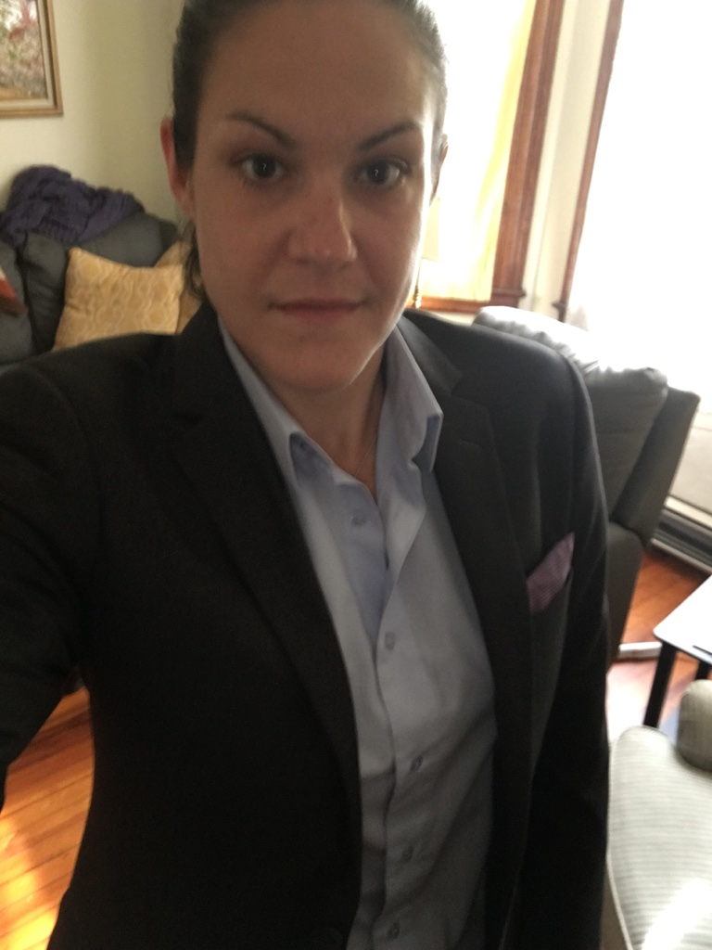
Sustainable & Equitable Transportation in the Age of Climate Catastrophe
Presented by Gannon Long, Assistant Coordinator, Transport Hartford Academy Center for Latino Progress, Hartford, CT
Prologue: What are we learning about sustainability in the age of COVID?
How do our individual, organizational, local government, and state policy choices enhance or threaten our transportation options in CT?
Intro to the Transportation & Climate Initiative: How CT can cap pollution & invest in communities

Slide 2
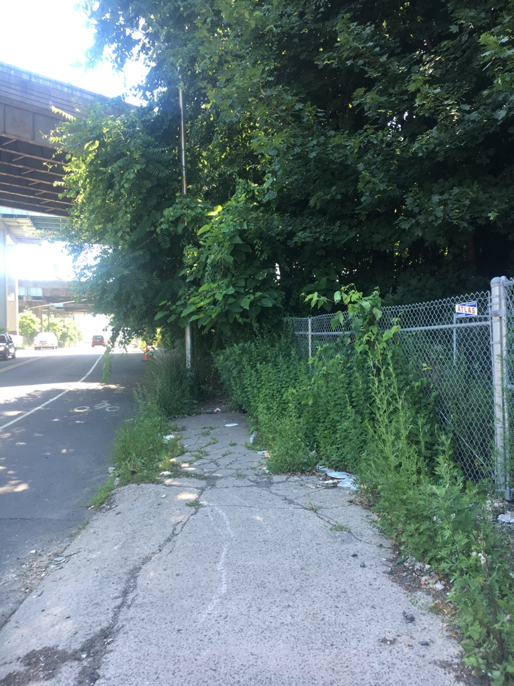
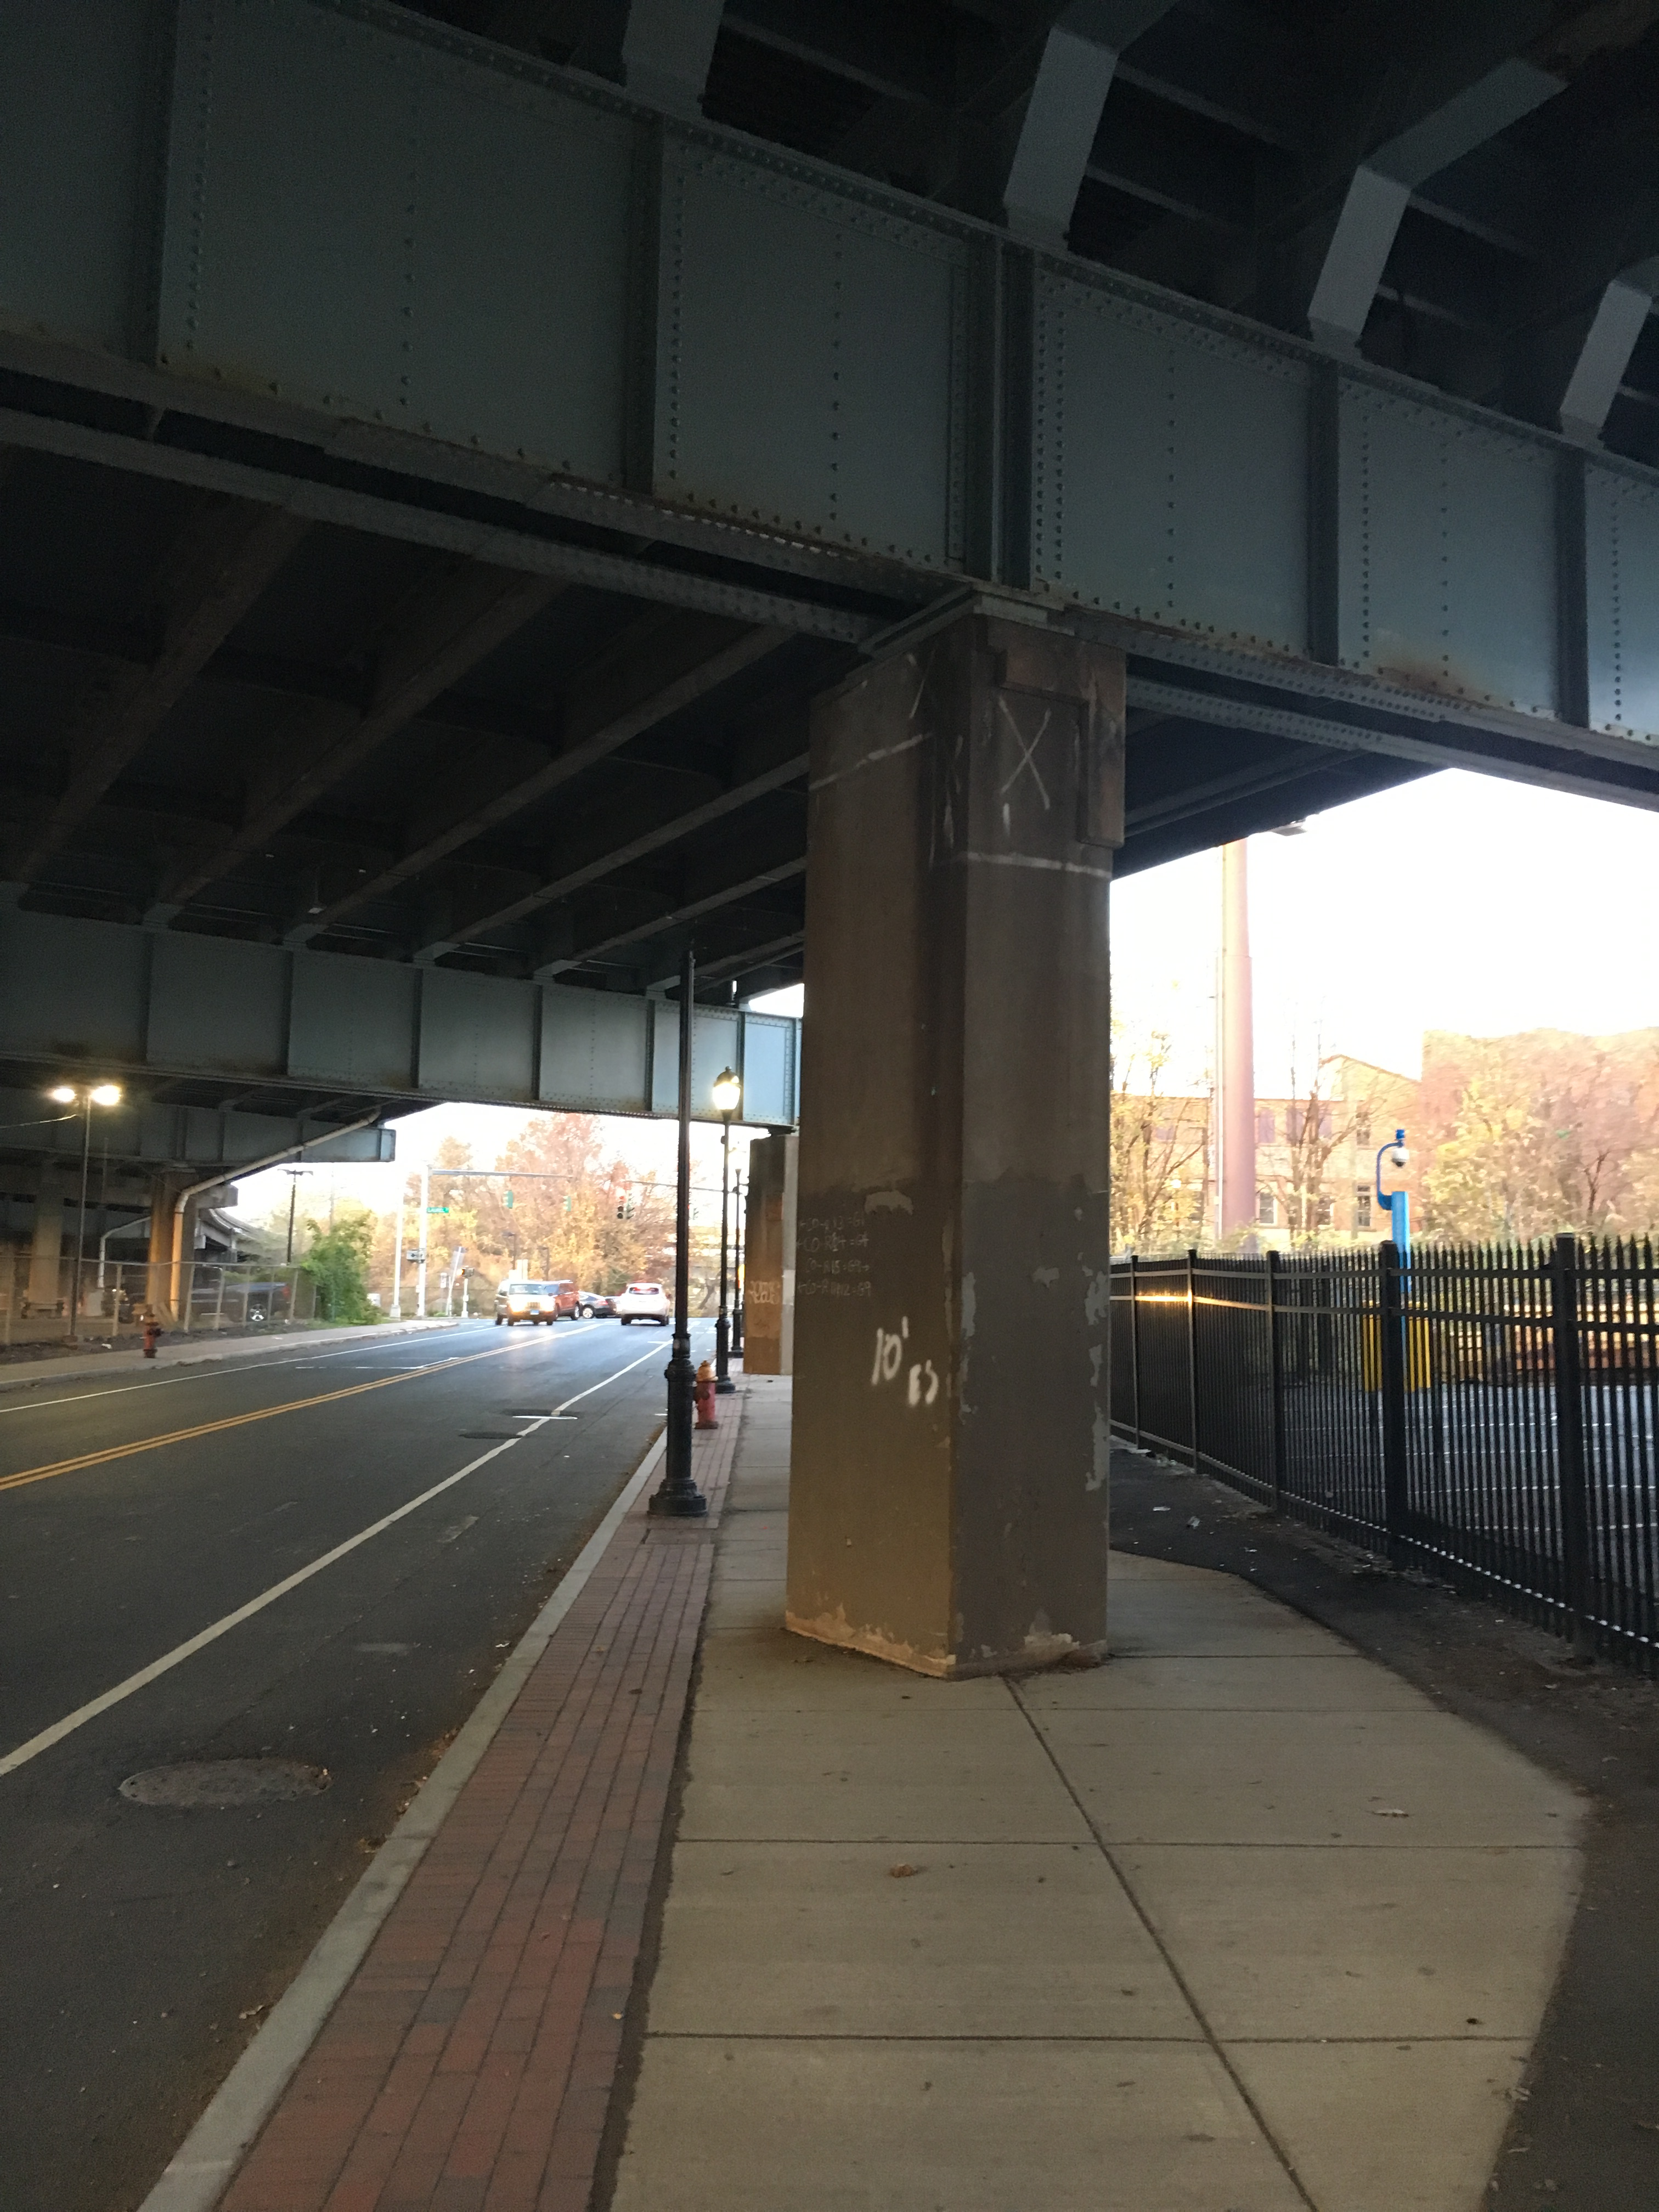
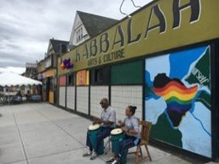
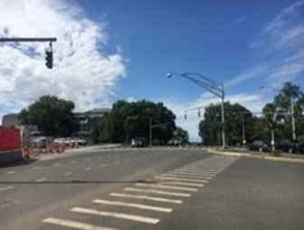
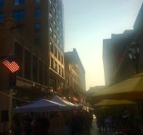
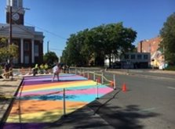
Which walking/ biking experiences do you prefer? Why?

Slide 3
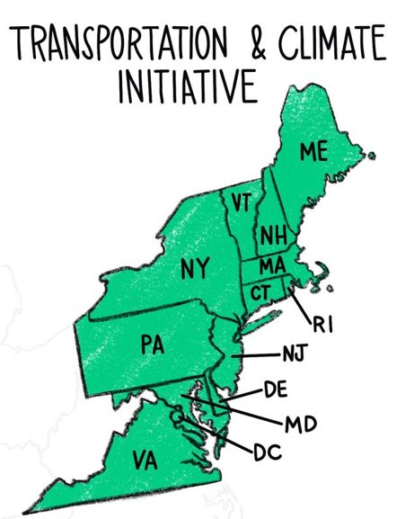
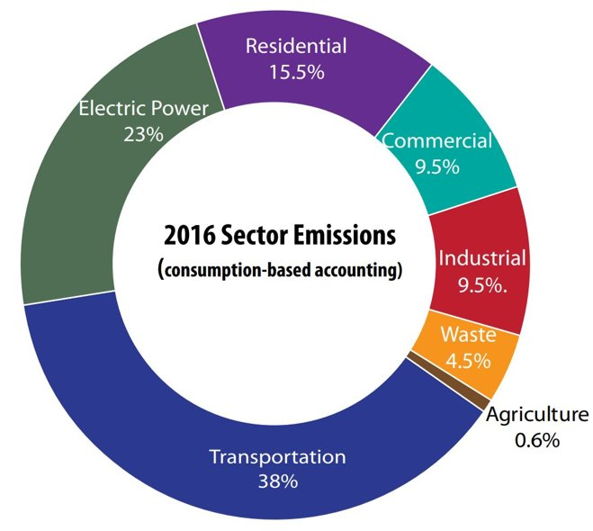
Greenhouse gas contributions from transportation: Which category/ies stand out?
Connecticut: Greenhouse Gas
Transportation and Climate Initiative is a coalition of northeastern states, working for years to develop a regional policy to provide better, cleaner transportation options for residents of urban, suburban, and rural areas.
This effort, similar to the Regional Greenhouse Gas Initiative capping pollutants, could generate revenue to transform equitable and sustainable transportation in CT.

Slide 4
References
Vision Zero/ American Public Transportation study on traffic safety & buses APTA/ Vision Zero Study
November 2019 Northeast Multi Modal Summit Presentations
11/19 Keynote Address, Charles Brown – transportation equity
Info on TCI Survey Transportation Future Survey Results (CLP)
Capital Region Council of Governments 2017 Transportation Plan
Move New Haven Bus Plan Gannon Long, Speech to League of Conservation Voters, Jan. 2020
Follow Up
Join our Email newsletter Take our survey: http://www.tinyurl.com/ctfuture2019
Follow our Facebook page: https://www.facebook.com/TransportHartford/ Discuss transportation topics in our FB group: https://www.facebook.com/groups/TransportHartfordGroup/

