Slide 1
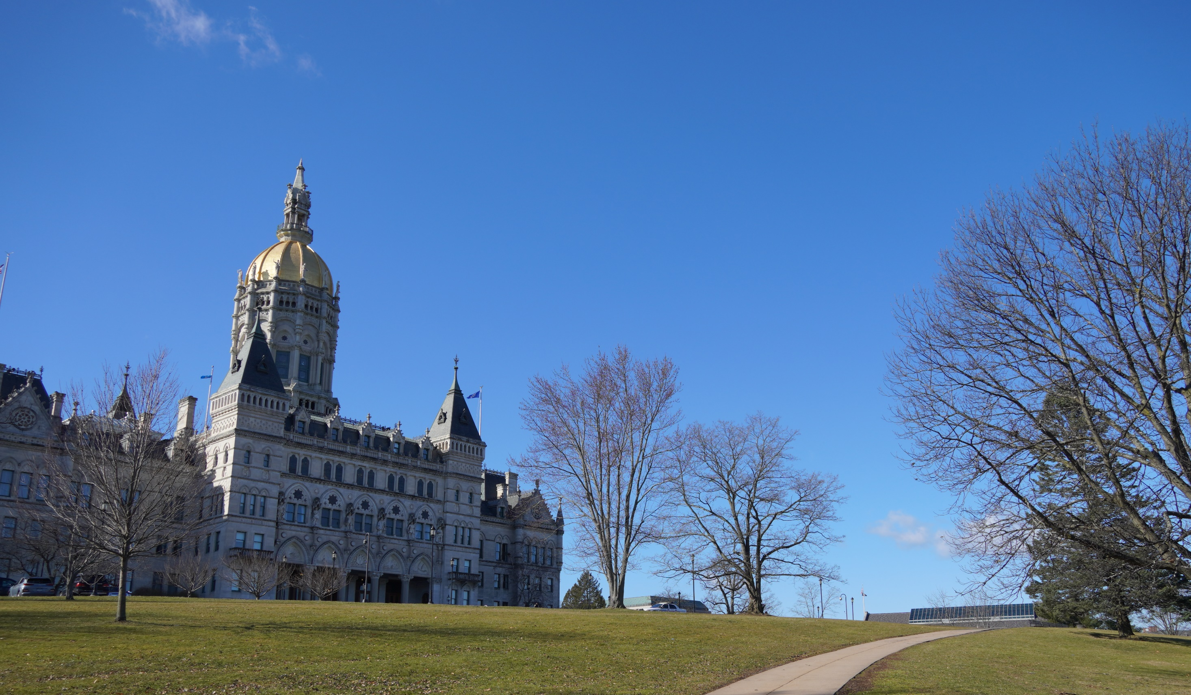
Connecticut Green Transportation Policy & Legislation In the 2020 Session
Save the Sound
April 3, 2020
Charles Rothenberger, Climate & Energy Attorney

Slide 2
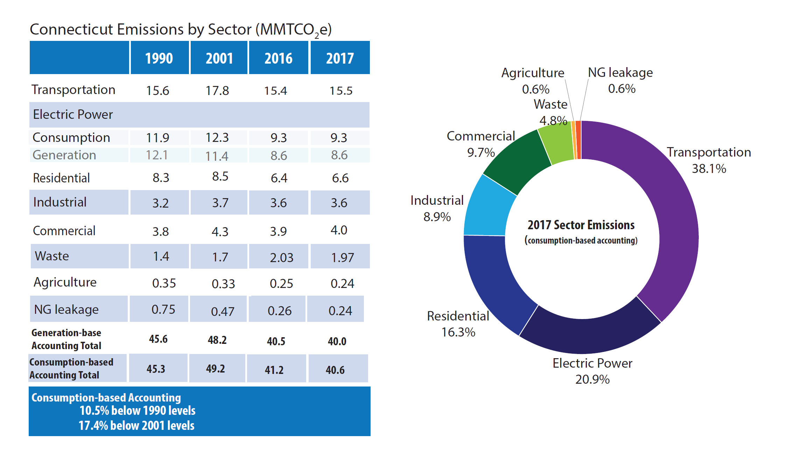
CT Greenhouse Gas Emissions Inventory (2017)
Source: CT DEEP

Slide 3
2020 Legislative Session Timeline
Short Session Schedule (State Constitution)
Convenes February 5th; Adjourns May 6th
Suspended Business on March 12th
Scheduled to Resume March 30th
Scheduled to Resume April 13th
Committee Deadlines (Joint Rules)
Transportation 3/20 [3/25]
Energy & Technology 3/24 [3/27]
Finance, Revenue & Bonding 4/2 [4/7]
Appropriations 4/3 [4/8]
Options to Move Legislation
Petition Process
Within one week of the Committee deadline
Emergency Certification
Special Session
?
?
Notes:
.

Slide 4
Legislative Activity
Broad Climate Bills
S.B. No. 10 AN ACT CONCERNING CERTAIN RECOMMENDATIONS REGARDING CLIMATE CHANGE. (ET 3/5 PH)
S.B. No. 354 AN ACT ESTABLISHING A GREEN NEW DEAL FOR CONNECTICUT (LAB 3/3/ PH)
EV Bills
S.B. No. 5226 AN ACT CONCERNING ELECTRIC VEHICLE CHARGING STATIONS. (ET 2/27 PH)
H.B. No. 5228 AAC THE COMMERCIAL PROPERTY ASSESSED CLEAN ENERGY PROGRAM. (ET 2/27 PH)
H.B. No. 5008 AN ACT CONCERNING THE ESTABLISHMENT OF HIGH PERFORMANCE GREEN BUILDING STANDARDS FOR VOLUNTARY ADOPTION BY MUNICIPALITIES. (ET 3/5 PH)
H.B. No. 5260 (RAISED) AN ACT CONCERNING DEALERSHIP FRANCHISES. (TRA 2/28 PH)

Slide 5
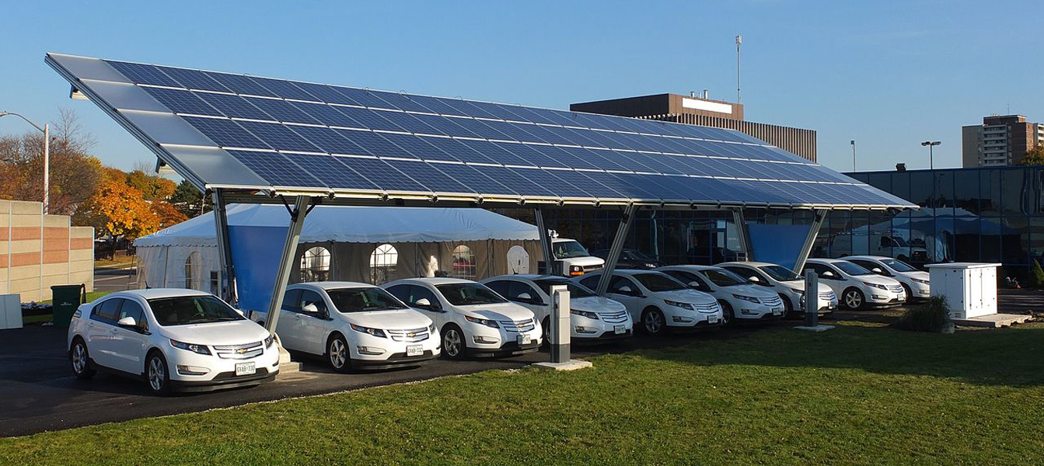
Administrative & Regulatory Activity
PUBLIC UTILITIES REGULATORY AUTHORITY
DEPARTMENT OF ENERGY & ENVIRONMENTAL PROTECTION
Grid Modernization Dockets
Energy Affordability
Advanced Metering Infrastructure
Battery Storage
ZEVs (Docket No. 17-12-03 RE04)
Innovation Pilots
MULTI-STATE ZEV MOU
CT EV ROADMAP
VW SETTLEMENT
CHEAPR PROGRAM
GOVERNOR’S COUNCIL ON CLIMATE CHANGE
TRANSPORTATION & CLIMATE INTIATIVE

Slide 6
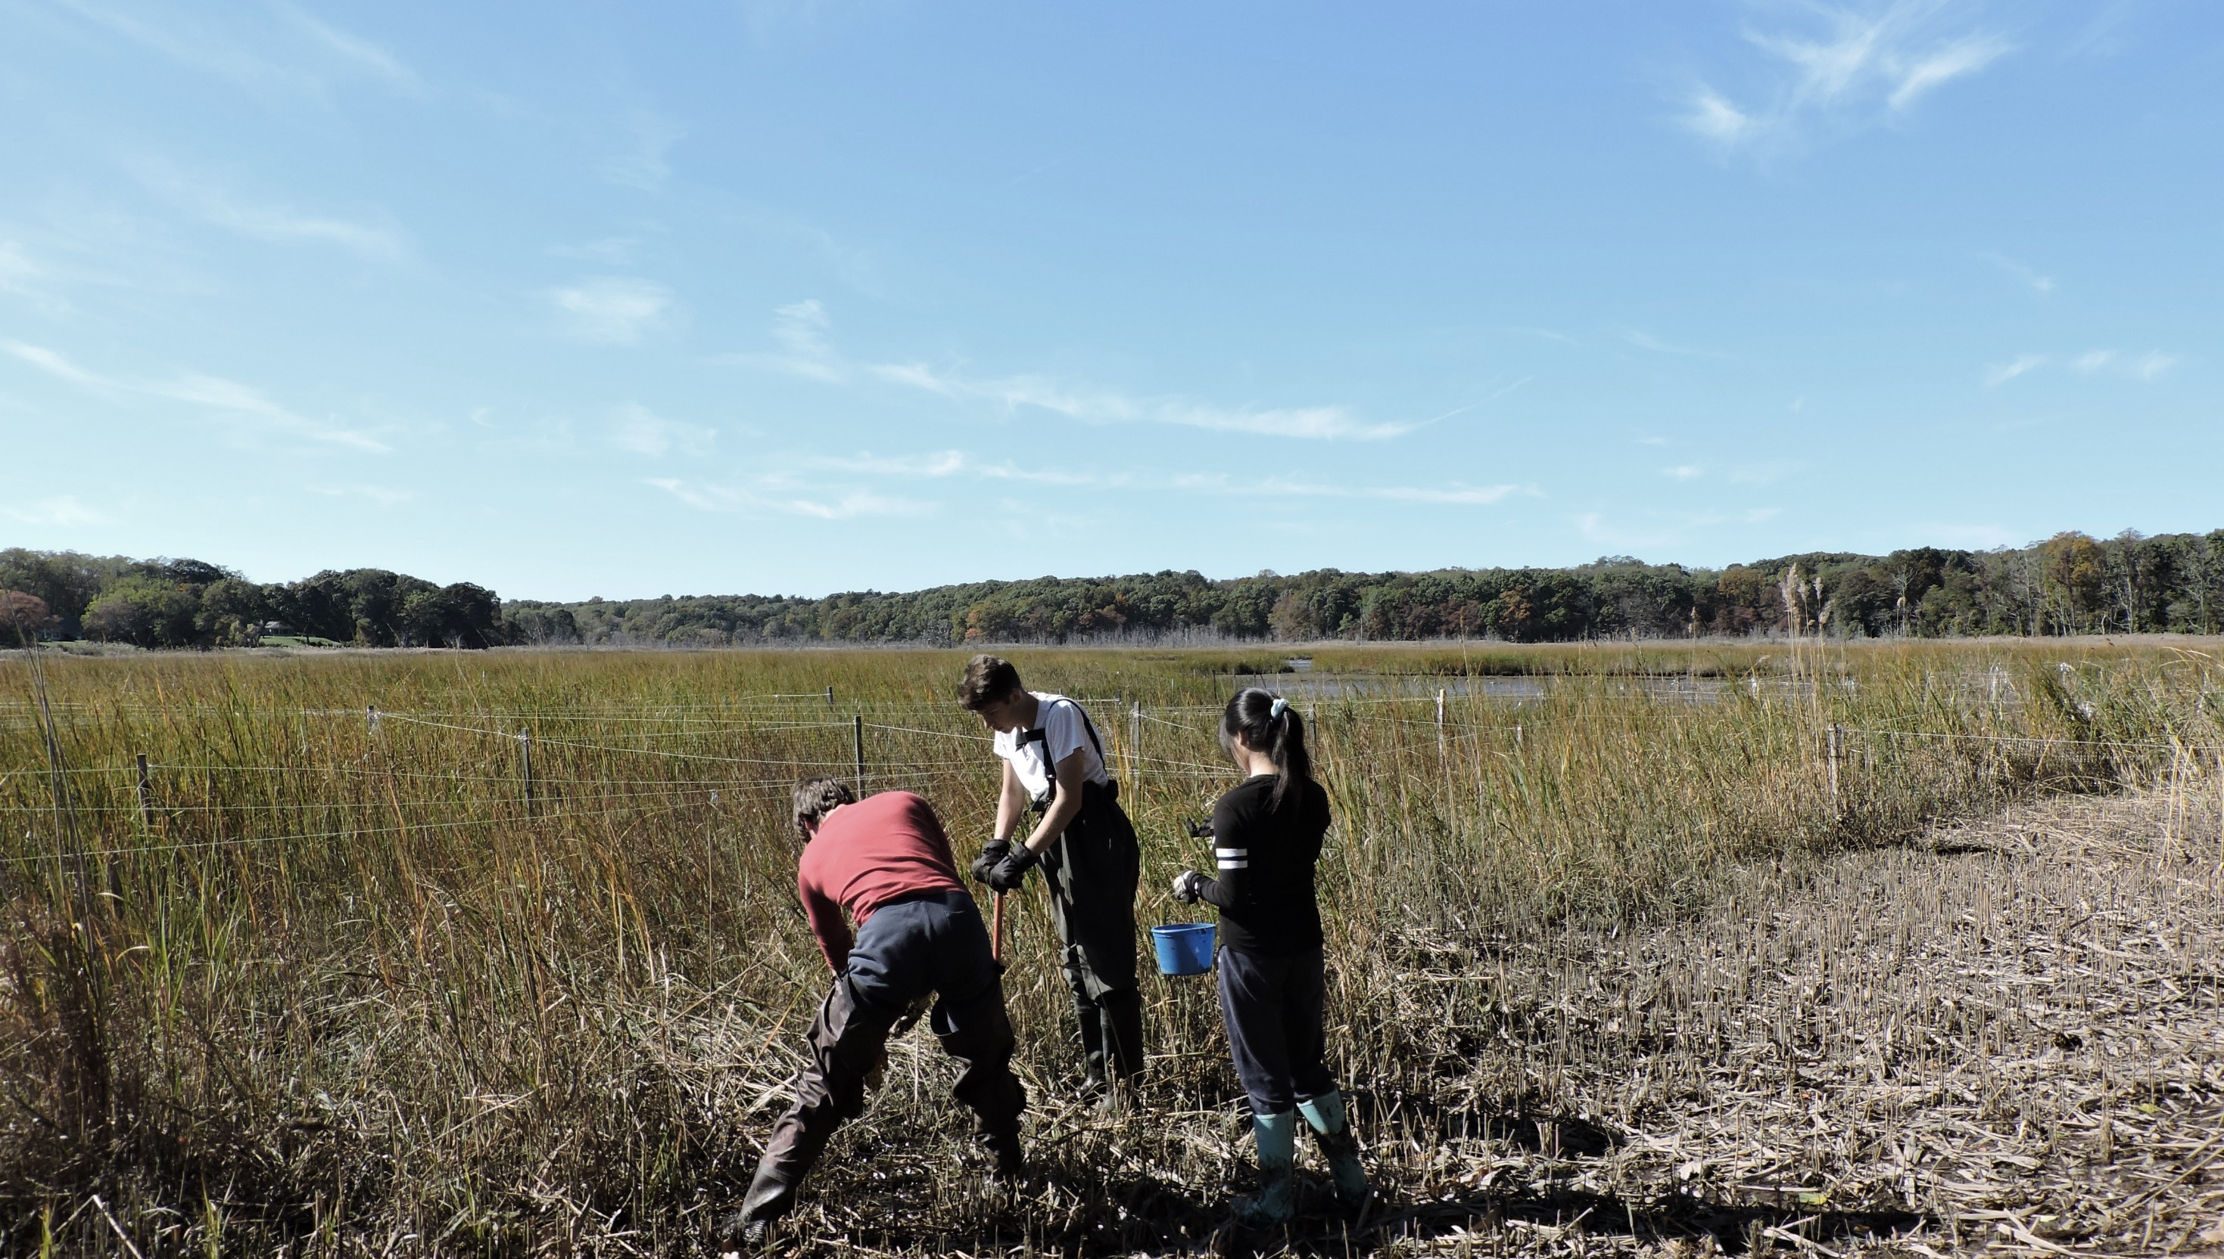
@savethesoundct
@cfe.savethesound
@savethesound
We envision a Long Island Sound region where the vitality of nature will be protected for people and wildlife, now and for many decades to come. A region in which citizens from all walks of life can unite in transforming struggling habitats, polluted waters, endangered wildlife, and a threatened planet into resilient, healthy, vibrant, and inspiring places that sustain communities.

